Slide 1
VERB TENSE CONSISTENCY
UNIT 1

Slide 2
VERB TENSE CONSISTENCY
There are three main verb forms for showing time or tense:
Simple Tense
does not use auxiliary verbs
refers to specific time period during which something happens OR something happened and is over OR something will happen
Simple present (action goes on now): I sit
Simple past: (action happened and is over): I sat
Simple future (action will happen): I will sit

Slide 3
VERB TENSE CONSISTENCY
Perfect Tense
uses have, has, or had as auxiliary verb
allows action to continue over time
Present perfect (action happened and may still be going on): I have sat
Past perfect (action happened before something happened in the past): I had sat
Future perfect (action will be considered in the future, by which time it will have already happened): I will have sat

Slide 4
VERB TENSE CONSISTENCY
Progressive Tense
uses is, are, was, or were as auxiliary verb with -ing ending on main verb
focuses on “progress” of action
Present progressive (action is in progress right now): I am sitting
Past: progressive (action was in progress in the past): I was sitting
Future progressive (action will be in progress in the future): I will be sitting
Each of the above tenses denotes a specific time for an action or event to take place. Writers should be careful to use the exact tense needed to describe, narrate, or explain.
In general . . .
Do not switch from one tense to another unless the timing of an action demands that you do.
Keep verb tense consistent in sentences, paragraphs, and essays.

Slide 5
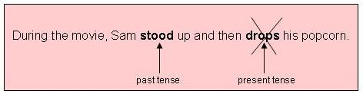
Verb tense consistency on the sentence level
Keep tenses consistent within sentences.
Do not change tenses when there is no time change for the action.
Incorrect:

Slide 6
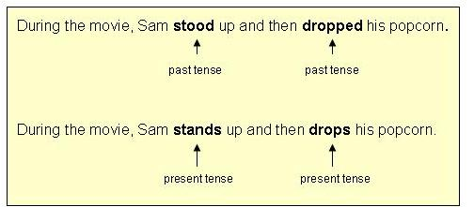
Correct:
Since there is no indication that the actions happened apart from one another.,
there is no reason to shift the tense of the second verb.

Slide 7
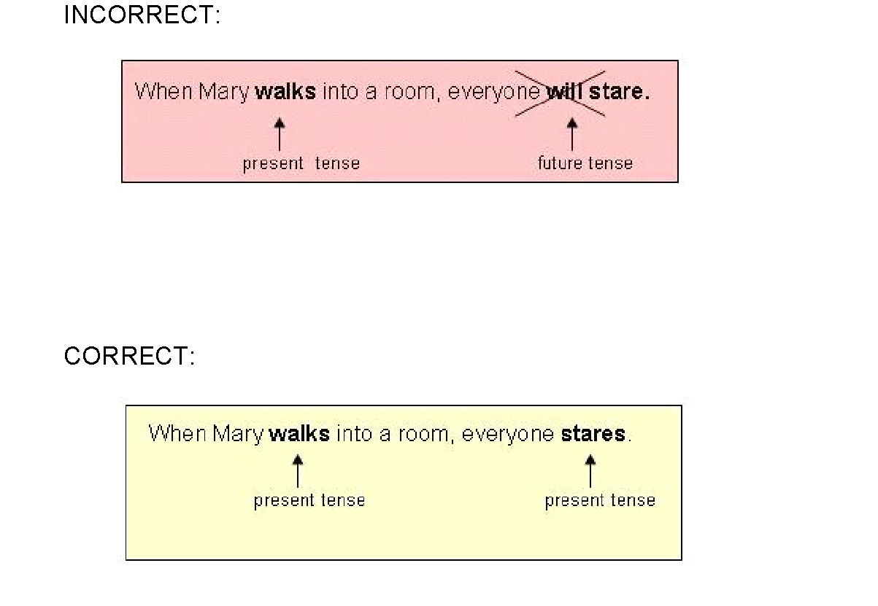

Slide 8
The above sentence means that Mary walks into a room at times. The action is habitual present. The second action happens when the first one does. Therefore, the second verb should be present as well.
Change tense only when there is a need to do so. Usually, the timing of actions within a sentence will dictate when the tense must change.

Slide 9
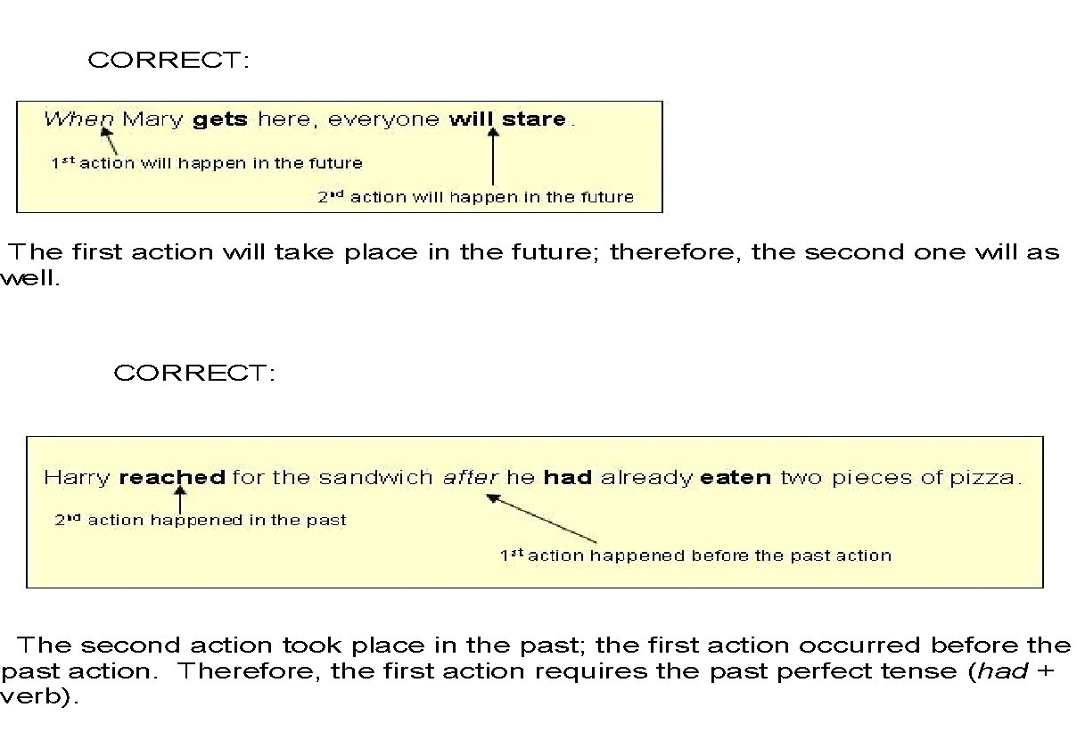

Slide 10
VERB TENSE CONSISTENCY ON THE PARAGRAPH LEVEL
•Generally, establish a primary tense and keep tenses consistent from sentence to sentence.
•Do not shift tenses between sentences unless there is a time change that must be shown.

Slide 11
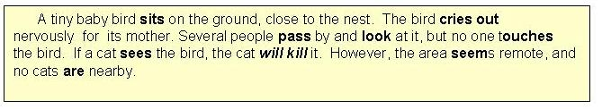
PRESENT TENSE PARAGRAPH
All actions in the above paragraph happen in the present except for the
future possibility dependent upon a present action taking place:
" If a cat sees the bird, the cat will kill it."

Slide 12
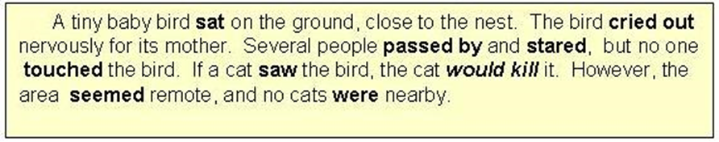
PAST TENSE PARAGRAPH
All of the actions in the above paragraph happen in the past except
for the possibility dependent upon one action taking place:
"If a cat saw the bird, the cat would kill it."

Slide 13
VERB TENSE CONSISTENCY ON THE ESSAY LEVEL
1. Use present tense when writing essays about
• your own ideas
• factual topics
• the action in a specific movie, play, or book

Slide 14
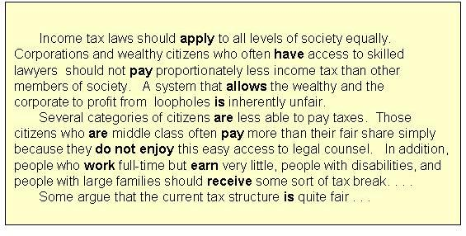
YOUR OWN IDEAS

Slide 15
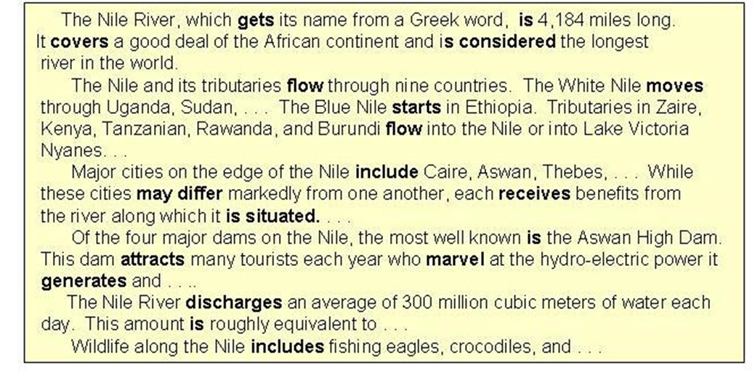
FACTUAL TOPIC

Slide 16
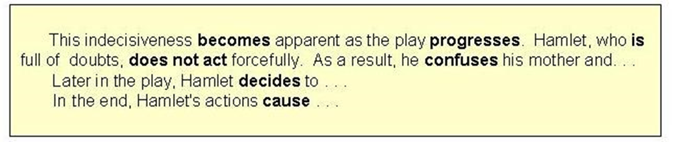
ACTION IN A SPECIFIC MOVIE OR BOOK
NOTE: When quoting from a work, maintain the present tense in your own writing, while keeping the original tense of the quoted material.

Slide 17
VERB TENSE CONSISTENCY ON THE ESSAY LEVEL
2. Use past tense when writing about
• past events
• completed studies or findings, arguments presented in scientific literature

Slide 18
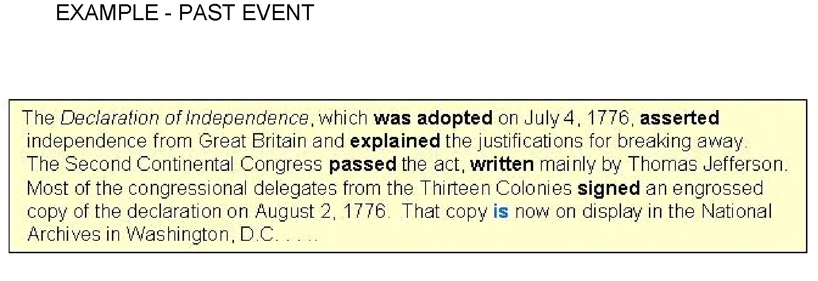

Slide 19
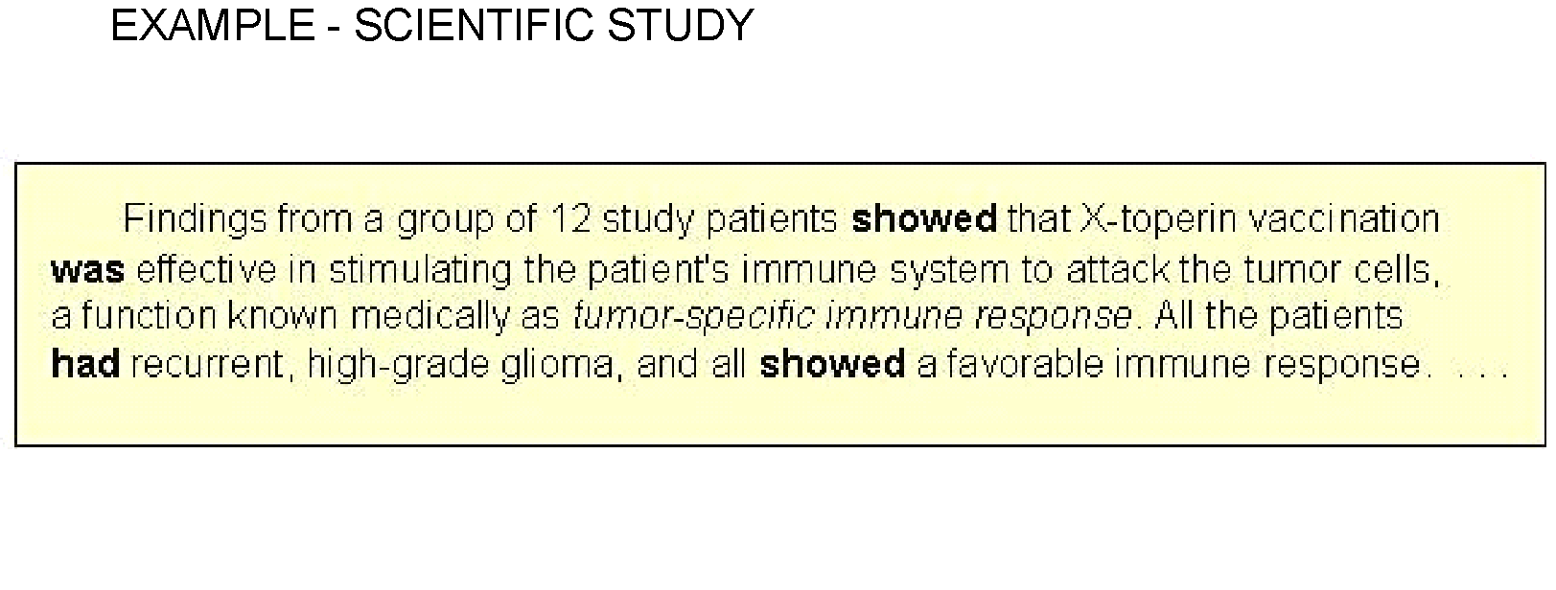

Slide 20
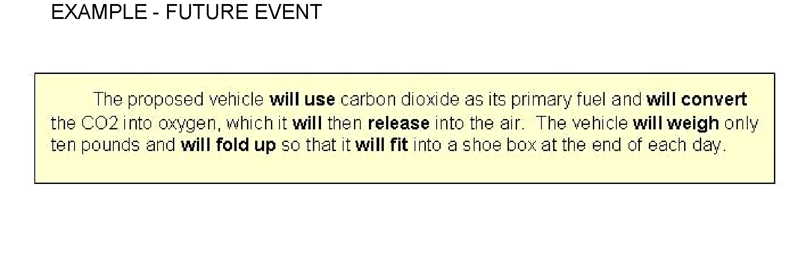
VERB TENSE CONSISTENCY ON THE ESSAY LEVEL
3. Use future tense when writing about
• an event that will occur in the future.

Slide 21
TENSE CONSISTENCY EXERCISE
Complete the following sentences using an appropriate verb form.
1. If the company followed the quality guidelines, they ……………………… not land in trouble.
Would b) will
2. The telephone ……………………. while I was having a bath.
Rings b) rang
3. Since its conception in the early 1970s, the internet ………………………. in popularity.
Grew b) has grown
4. If she had acted more responsibly, everything …………………………… all right.
would be b) would have been
5. Thousands of people ………………………… see the art exhibition before it closes on Friday.
a) Will b) would have

Slide 22
TENSE CONSISTENCY EXERCISE
Complete the following sentences using an appropriate verb form.
6. Captain James Cook ………………………. by Hawaiian islanders in
1779 while he was on a visit to Alaska.
Killed b) was killed
7. I was terribly disappointed with my marks because I ……………………… really hard.
Worked b) had worked
8.The teacher started asking questions as soon as she ………………………… the lessons.
Finished b) finishes
9. Everyone ……………………… that she would return safely.
Hopes b) hoped
10. The boy confessed that he ………………………. the money.
a) has taken b) had taken

Slide 23
ANSWERS
1. If the company followed the quality guidelines, they would not land in trouble.
2. The telephone rang while I was having a bath.
3. Since its conception in the 1970s the internet has grown in popularity.
4. If she had acted more responsibly everything would have been all right.
5. Thousands of people will see the art exhibition before it closes on Friday.
6. Captain James Cook was killed by Hawaiian islanders in 1779 while he was on a visit to Alaska.
7. I was terribly disappointed with my marks because I had worked really hard.
8. The teacher started asking questions as soon as she finished the lessons.
9. Everyone hoped that she would return safely.
10. The boy confessed that he had taken the money.

Slide 24
Thank you

